Slide 1

AUGUST 26, 2020
YOUR QUESTIONS ANSWERED
Learn about PPP Loan Forgiveness

Slide 2
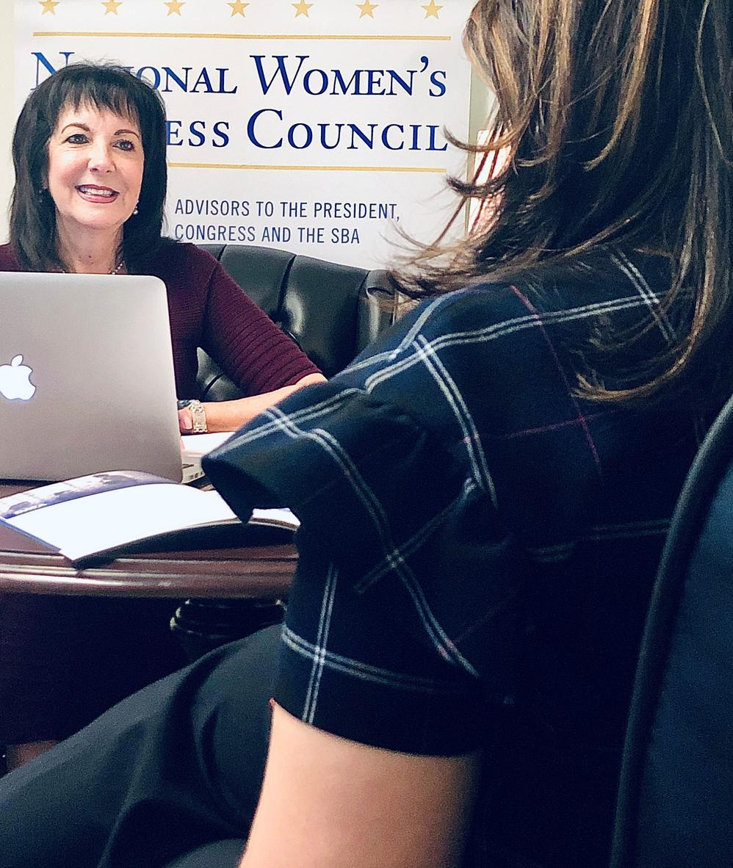
Today's Presentation
PRESENTERS
  Nina Roque, NWBC Executive Director
  Bill Briggs, Deputy Associate Administrator, SBA Office of Capital Access
  Rebecca Hamilton, NWBC Council Member & co-CEO of Badger Co.
  Jeff Bass, SBA Office of Rural Affairs
#WebinarWednesday

Slide 3

About NWBC
NWBC Executive Director, Nina Roque

Slide 4

Learn more at www.NWBC.gov

Slide 5
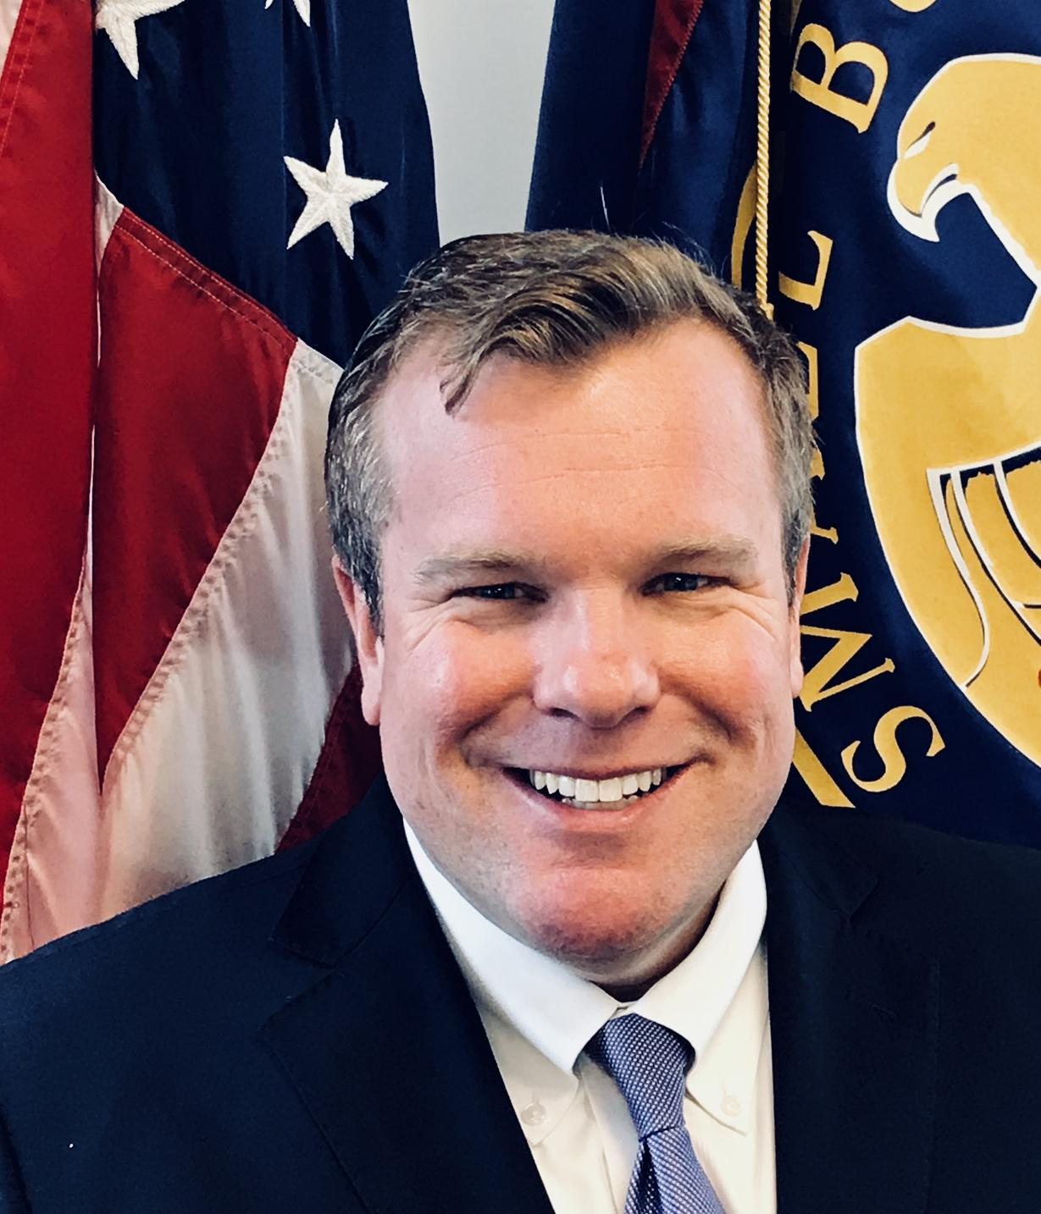
FEATURED REMARKS
Bill Briggs
Deputy Associate Administrator,
SBA Office of Capital Access

Slide 6
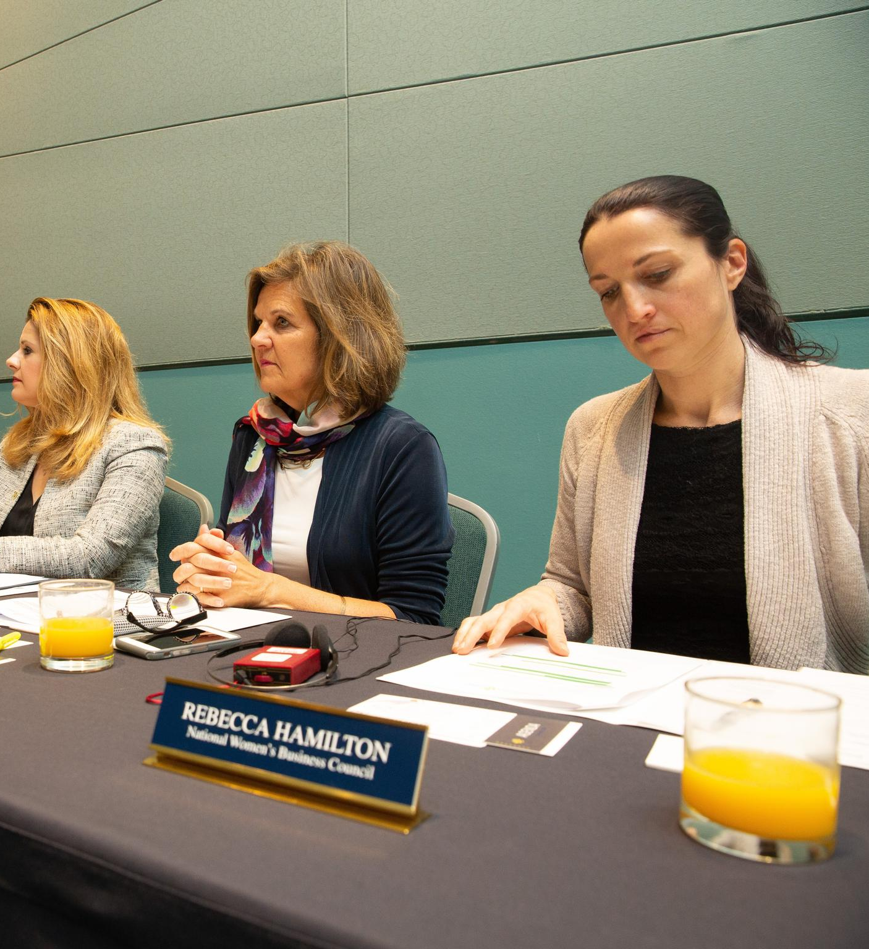
REBECCA HAMILTON
NWBC Council Member
Co-CEO, Badger
Rebecca Hamilton is the owner and co-CEO at Badger, a natural and organic personal care products manufacturer known for its unique company philosophy, pioneering family-friendly benefits, and B Corp community engagement.

Slide 7
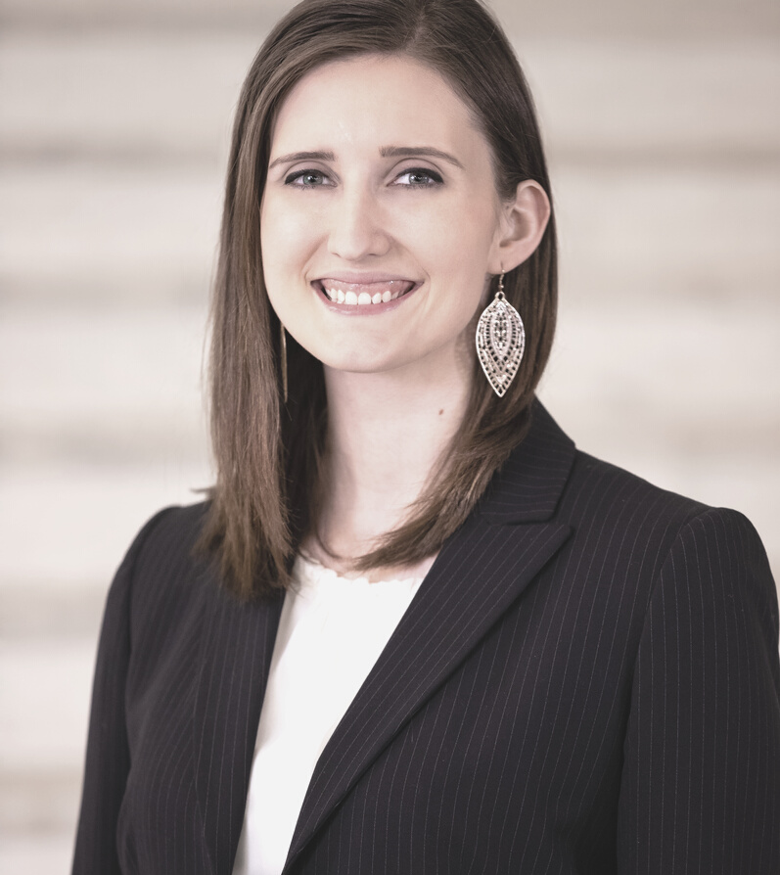


KRISTIN WILEMAN
SBA, Office of Rural Affairs
Quick overview of SBA's Office of Rural Affairs
JEFF BASS
Introductions
SBA Office of Rural Affairs
Quick overview of PPP Forgiveness
Q&A with NWBC Council Member Rebecca Hamilton
REBECCA HAMILTON
NWBC Council Member & co-CEO of Badger
Q&A with Jeff Bass
#WebinarWednesday

Slide 8
About SBA
Office of Rural Affairs
KRISTIN WILEMAN
Our commitment to rural businesses:
  Ensure you have access to financial assistance through the SBA’s lending programs
  Equip you with information on assistance available through the SBA and other government agencies
  Enable you to expand your network through our ongoing interactions with nongovernment organization that provide opportunities for rural entrepreneurs and small businesses
How do we serve rural communities?
  COVID response to assist small business
  Increase access to lending programs
  Expand export assistance and rural partnerships with USDA
  Amplify rural Opportunity Zones and HUBZones
#WebinarWednesday

Slide 9

JEFF BASS
SBA, Office of Rural Affairs
Jeff Bass recently joined the SBA Office of Rural Affairs.
For most of his career, he has been in commercial banking, working for community banks and a regional bank. Jeff’s background includes commercial real estate and business lending, including several iterations of SBA lending. Jeff helped establish SBA departments and also formed and grew a national specialty real estate group.
#WebinarWednesday

Slide 10
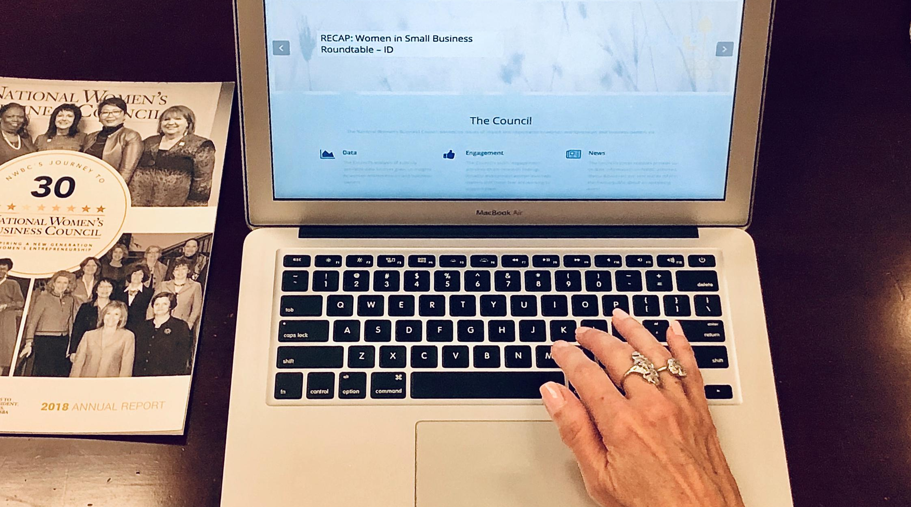
PPP LOANS
5,212,128
As of August 8, 2020, the
U.S. Small Business Administration distributed 5,212,128 loans through 5,460
lenders for a total of $525,012,201,124.

Slide 11

Rural
HOW DID BUSINESSES IN RURAL AREAS FARE?
Rural areas received 15.3% of total PPP loan dollar volume and 20.1% of total PPP loans.
*Through June 30, 2020
#WebinarWednesday

Slide 12

Application & Documentation
Where to find the PPP loan forgiveness application & What documentation is required?

Slide 13
WHERE TO FIND UP-TO-DATE PPP INFORMATION?
www.sba.gov/ppp
www.treasury.gov/cares
Please note: The presentation is intended as general information only and does not carry the force of legal opinion. This information is subject to change.
ADVICE
Borrowers Should Proceed With “Running the Numbers”
#WebinarWednesday

Slide 14
WHEN TO APPLY FOR FORGIVENESS?
Additional legislation/guidance that may impact PPP
  Potential for < $150,000 loans to have simplified process of forgiveness- timing uncertain
  Perhaps more PPP $ available, including a second loan for those businesses most severely impacted
  Additional PPP guidance from SBA & Treasury likely
Status of the Borrower
  What financial shape is the business in?
  Are business conditions for the business improving, worsening or staying the same?
  Has the borrower maintained the salaries/wages/FTEs?
  Has the borrower used all the loan proceeds for which they will request forgiveness?
  Has the borrower calculated their forgiveness amount?
    Eligible expenses
    Safe Harbor considerations
    FTE & Salary/Wage reductions
  Is existing PPP program guidance sufficient for the borrower to feel comfortable to proceed?
  Is lender ready to accept forgiveness applications?
    Focus: Maximum Forgiveness At the Right Time
#WebinarWednesday

Slide 15
WHAT IS THE FORGIVENESS REDUCTION CRITERIA?
  FTE retainage
  Salaries/Wages Reductions per employee
  Eligible payroll
    Be careful with owners’ compensation rules
    $100K salary limit for all employees (prorated for Covered Period)
  60% payroll expense threshold
  Eligible Non-Payroll Expenses
  EIDL Advance (this is done by SBA, but Borrower/Lender need to be aware of the amount)
ADVICE
Look for the “Low Hanging Fruit”
Eligible expenses easiest to document and that clearly meet the guidance/policy currently available
#WebinarWednesday

Slide 16

Audience Q&A
Drop your questions in the chat!

Slide 17

CONTACT INFORMATION
www.sba.gov/ppp
Jeffrey.Bass@SBA.gov
#WebinarWednesday

Slide 18



@NWBC
Follow NWBC
National Women's Business Council
#WebinarWednesday
@NWBCgov

